Slide 1
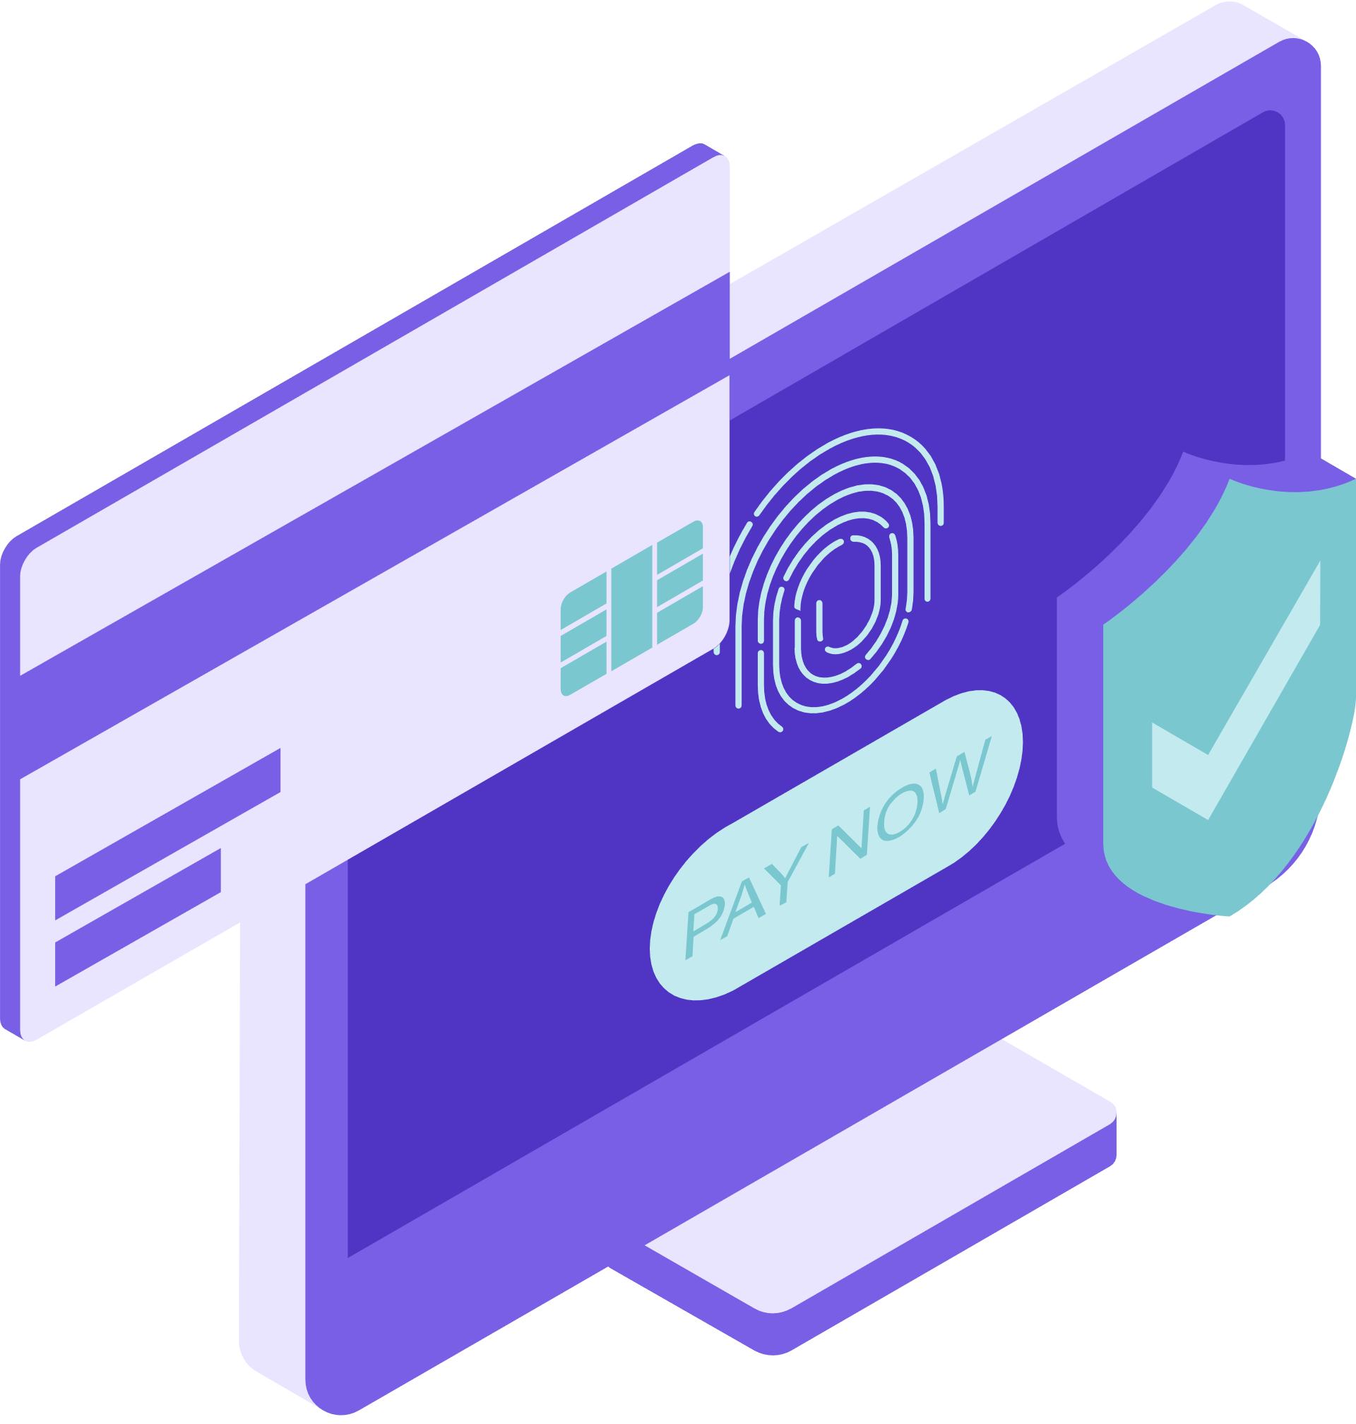
SOFTWARE QUALITY ASSURANCE
Online Banking System
Dana Orenkyzy, Arukhan Otarova

Slide 2
01 | Introduction
02 | Requirement
03 | Test Case / Test Execution
04 | Roadmap / Database
05 | Testing / Findings
06 | Recomendation
Outline
07
Conclusion

Slide 3
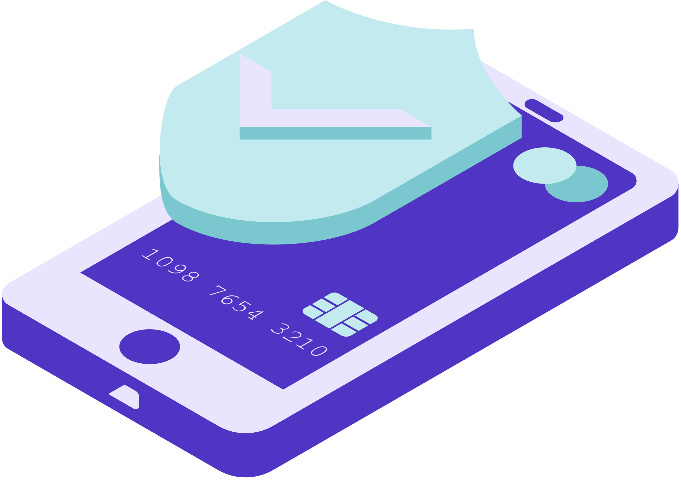
Introduction
The importance of testing in guaranteeing the dependability, security, and usability of online banking systems cannot be overstated. Online banking systems are sophisticated software applications that process sensitive financial transactions and user information. Thorough testing of these systems is required to discover and correct any flaws or vulnerabilities that might jeopardize the system's integrity or jeopardize user data.
The main purpose of testing an online banking system is to guarantee that it works properly and satisfies the standards. This includes ensuring that all features and operations, such as user identification, account management, fund transfers, bill payments, and transaction history, perform as intended. It also contains scenarios like valid and incorrect inputs, error handling, and system performance under various loads.

Slide 4
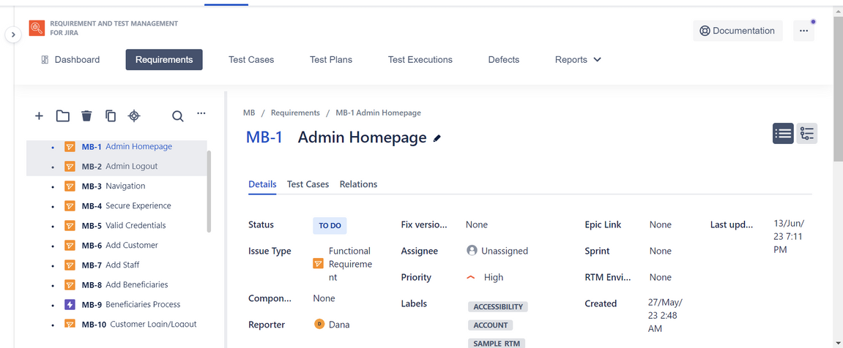
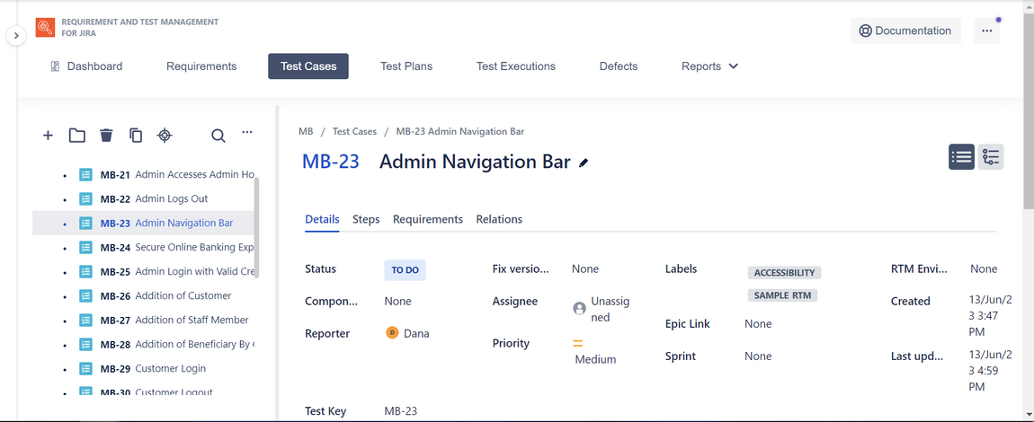
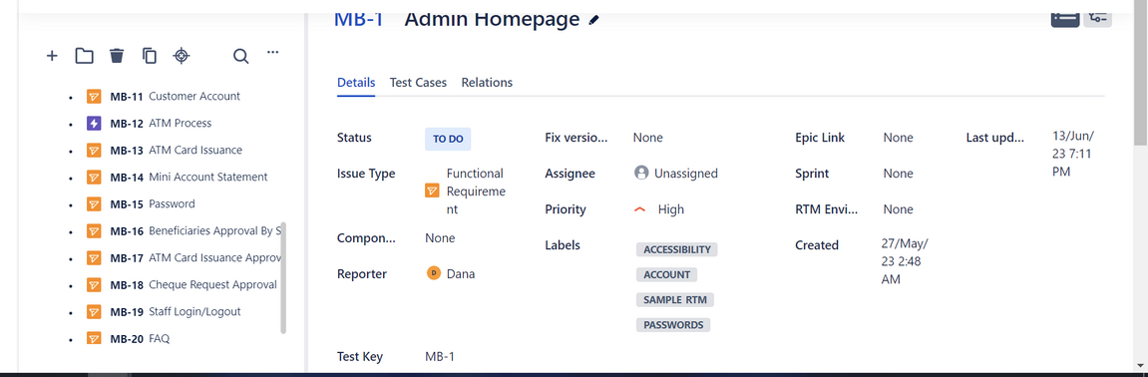
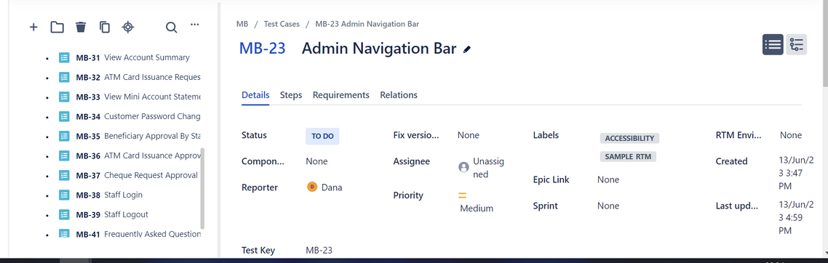
Requirement
Test Case

Slide 5
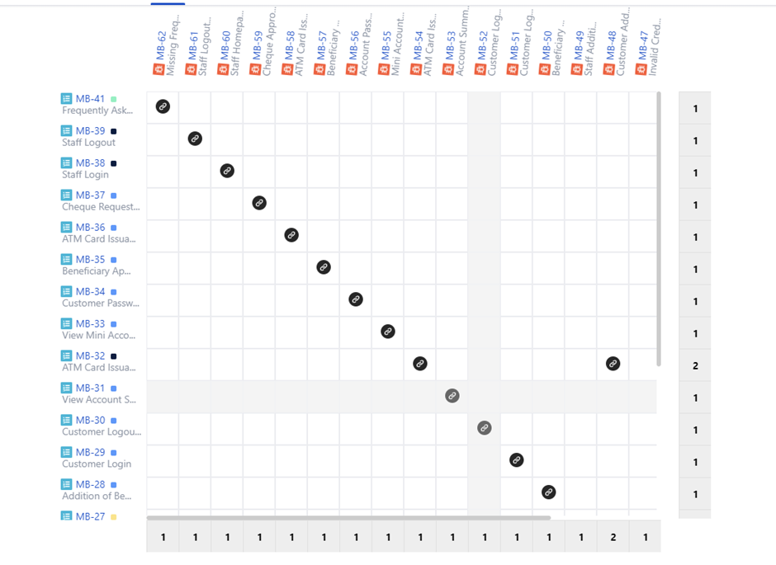
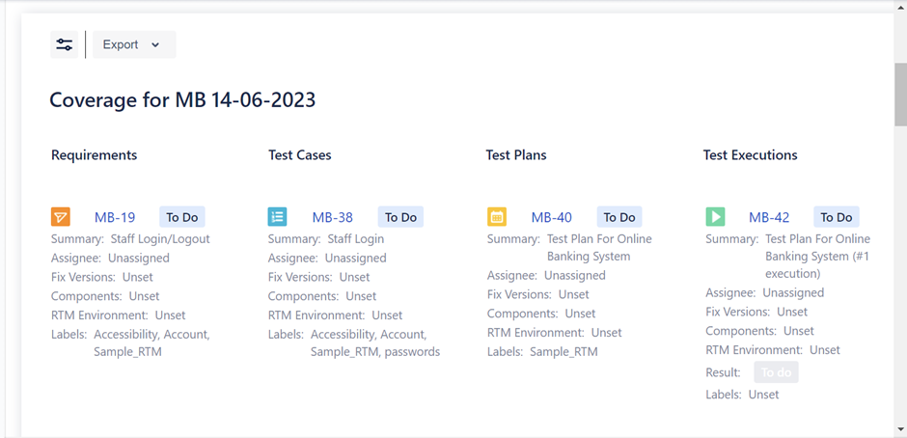
Report of Testing
Coverage Report
Traceability Report

Slide 6
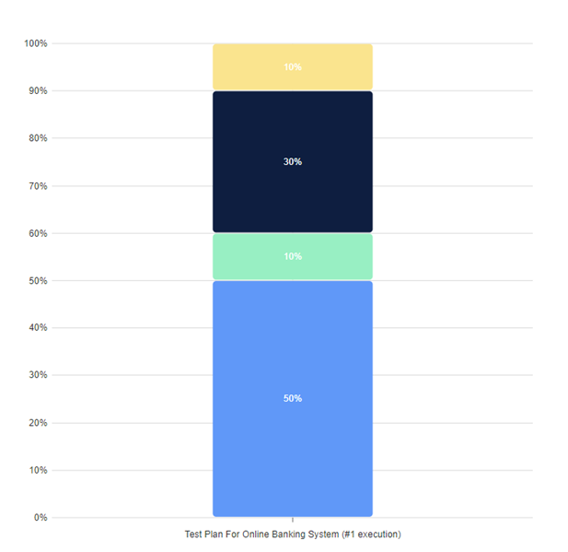
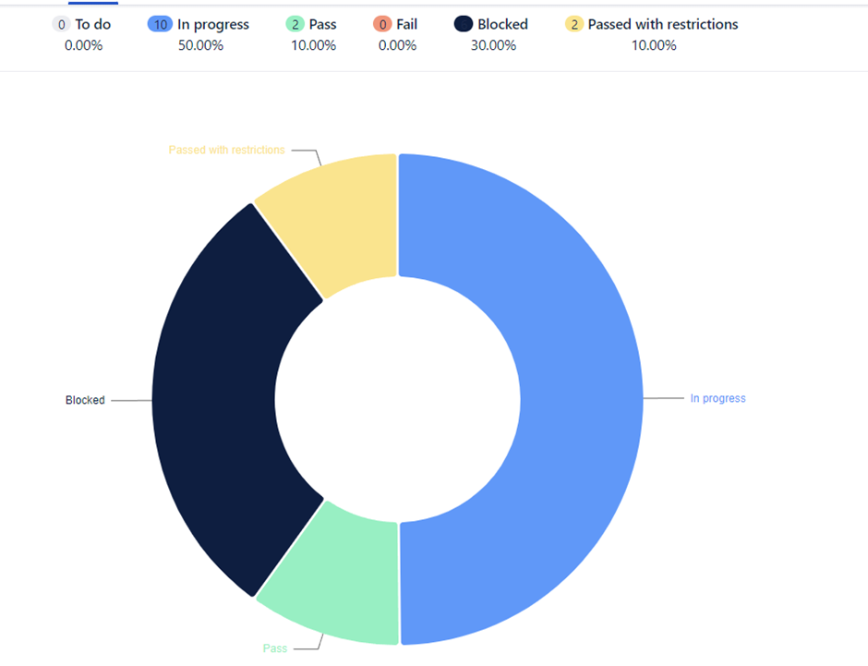
Report of Testing
Test Execution
Test Case Execution

Slide 7
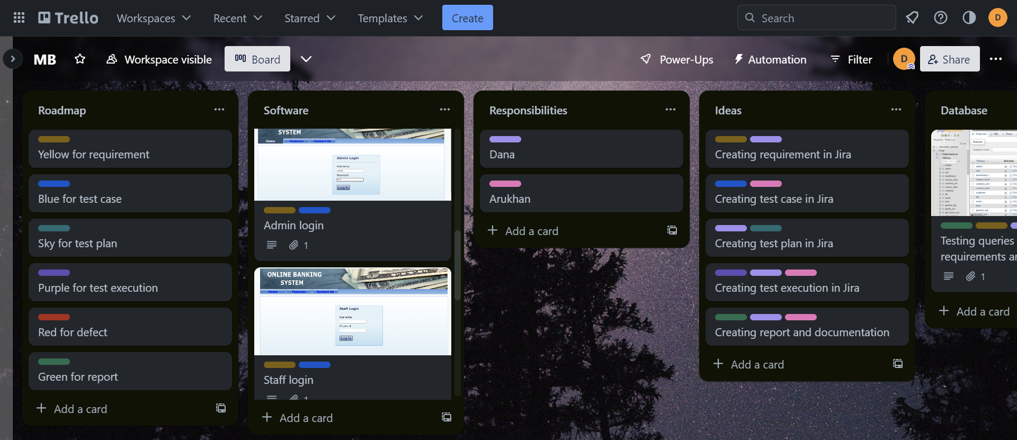
Roadmap

Slide 8
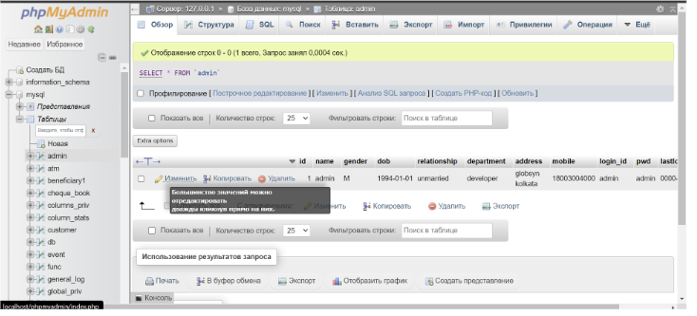
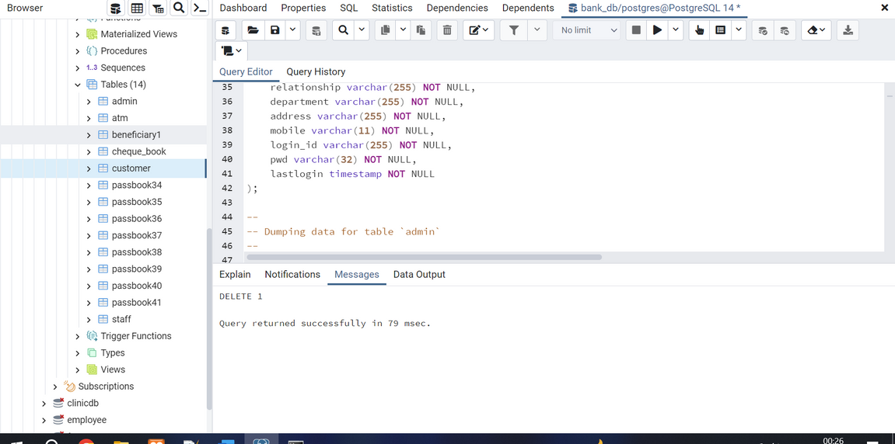
Database
phpMyAdmin
PgAdmin 4

Slide 9
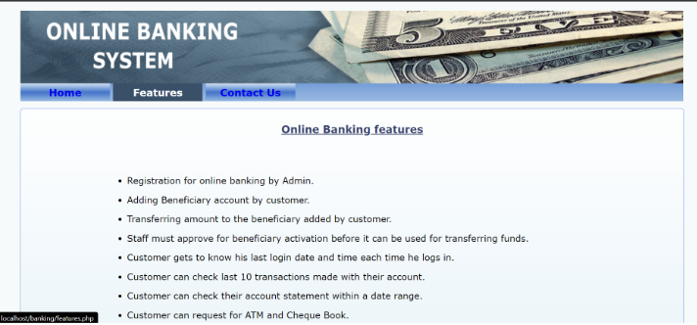
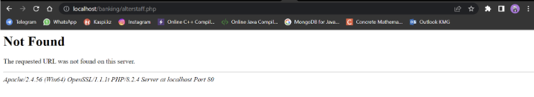
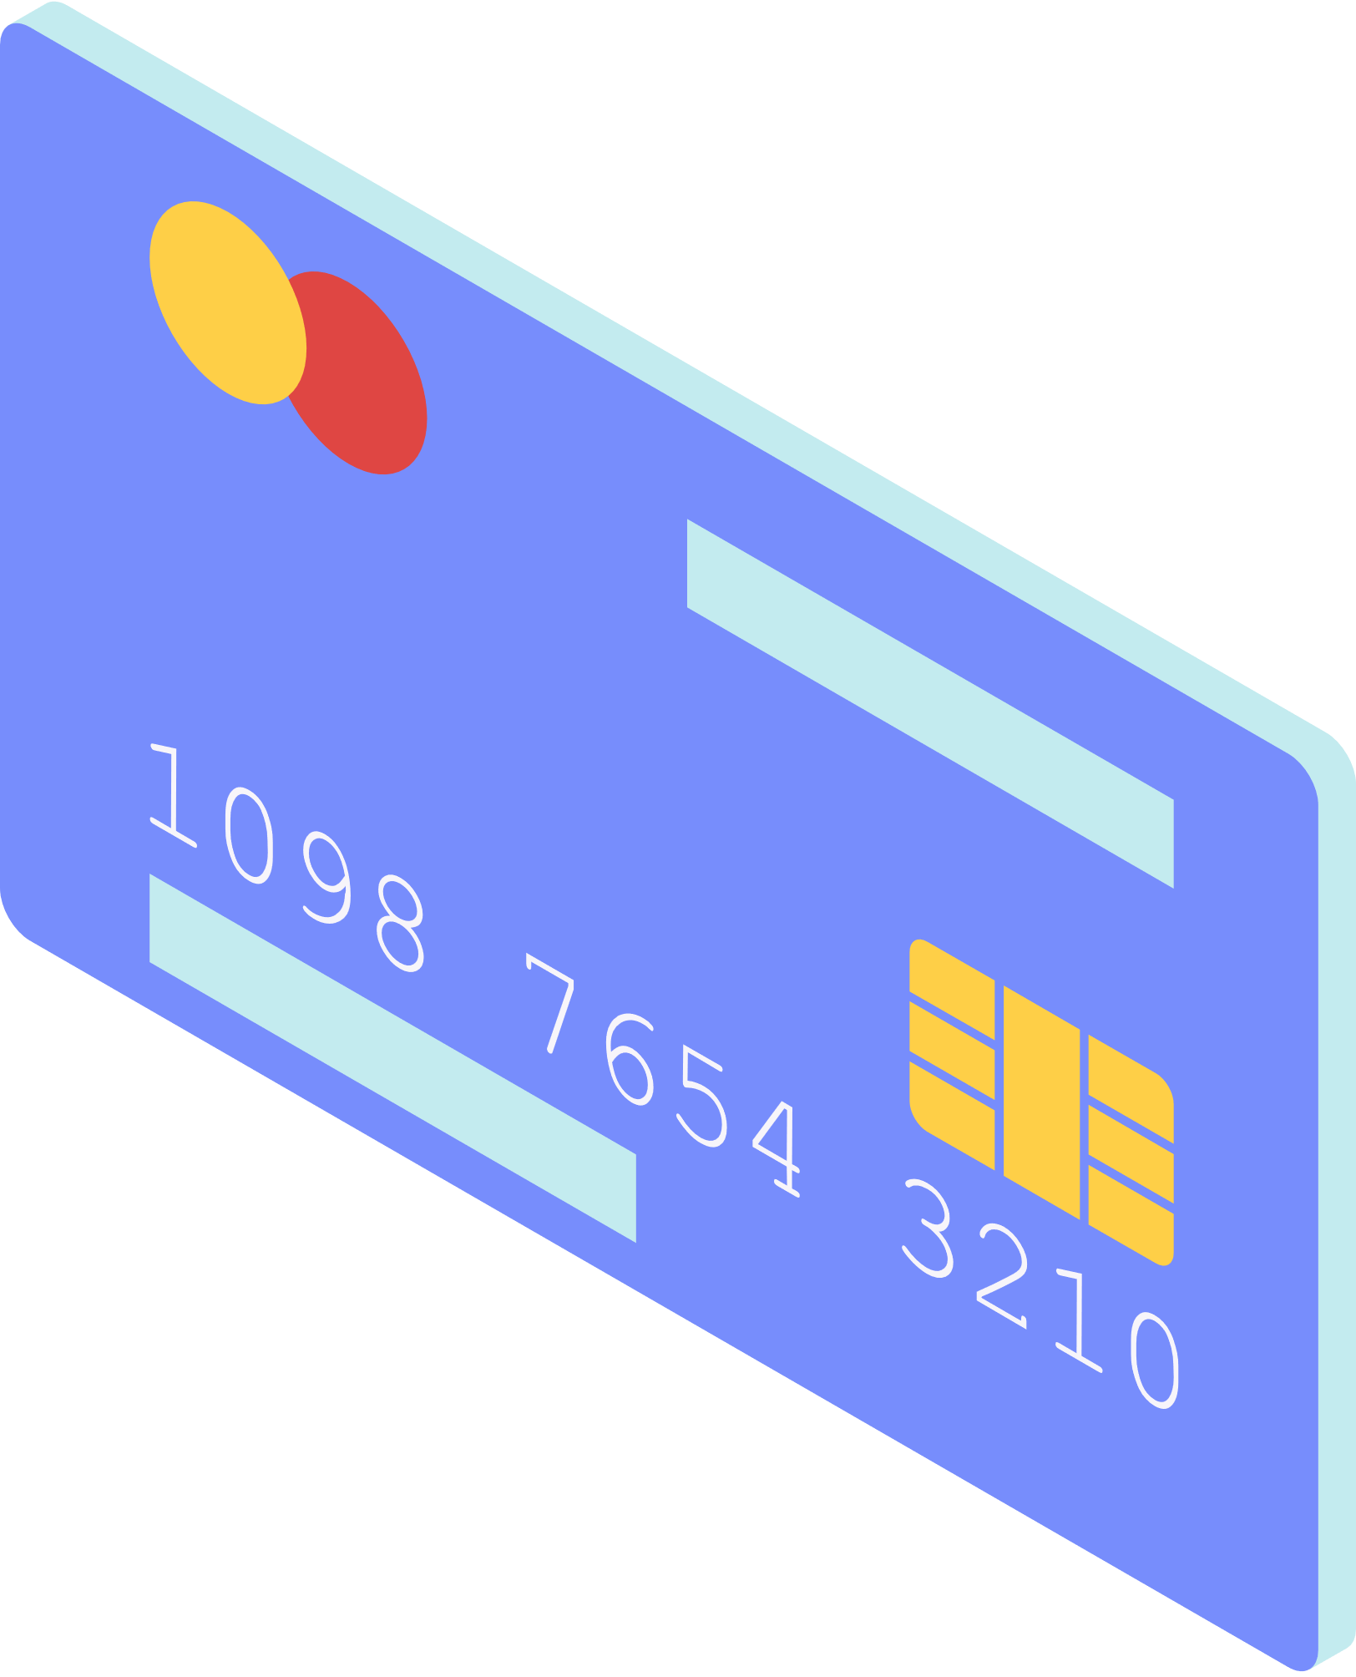
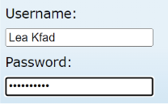
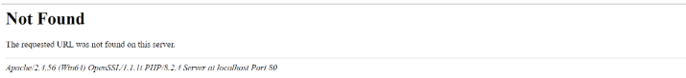
Usability Testing
Functionality Testing
Security Testing
Performance Testing
Testing

Slide 10

The identified defects pose challenges and hinder the smooth functioning of the system. The cheque approval failure prevents the proper processing of cheque approval requests, potentially causing delays in transactions. The staff homepage access denial restricts staff members from accessing essential information and performing their assigned tasks.
The staff logout failure results in an inability to properly terminate staff sessions, potentially compromising security. Lastly, the missing Frequently Asked Questions (FAQ) section deprives users of a valuable self-help resource, increasing their reliance on other support channels
Findings

Slide 11
01 | Enhance User Authentication: Implement multi-factor authentication (MFA) to add an extra layer of security for user logins.
02 | Implement Robust Encryption: Ensure that all sensitive data transmitted between the user's device and the online banking system is encrypted using secure protocols such as SSL/TLS.
03 | Implement Real-time Fraud Detection: Deploy advanced fraud detection systems that can analyze user behavior patterns, transaction history, and anomalies to identify potential fraudulent activities.
04 | Regular Security Audits and Penetration Testing: Conduct regular security audits and penetration testing to identify vulnerabilities in the online banking system.
Recommendation
List of recommendations for Improving Online Banking System

Slide 12
























Conclusion
It is crucial to address these defects promptly to enhance the overall user experience, streamline administrative processes, and ensure the system's reliability and security. The assigned students, Arukhan and Dana, play vital roles in investigating and resolving these defects. By resolving these issues, the system can improve functionality, security, and user satisfaction, resulting in a more efficient and user-friendly application or website.

